Slide 1
ALEXNET
BY:
THEJASWINI REDDY VOOTKURI.
SHOWRYA CHAKRA KOLLU.

Slide 2
CONTENTS
ImageNet
ILSVRC
Normalization
Architecture
Reducing Overfitting
Details of Learning
Results

Slide 3
ImageNet Classification with Deep Convolutional Neural Networks
ImageNet
ImageNet project was started in 2007.
Downloaded billion images from internet.
Used crowd-sourcing technology like Amazon Mechanical Turk platform to label those images.
50,000 workers, 167 countries helped to sort and label.

Slide 4


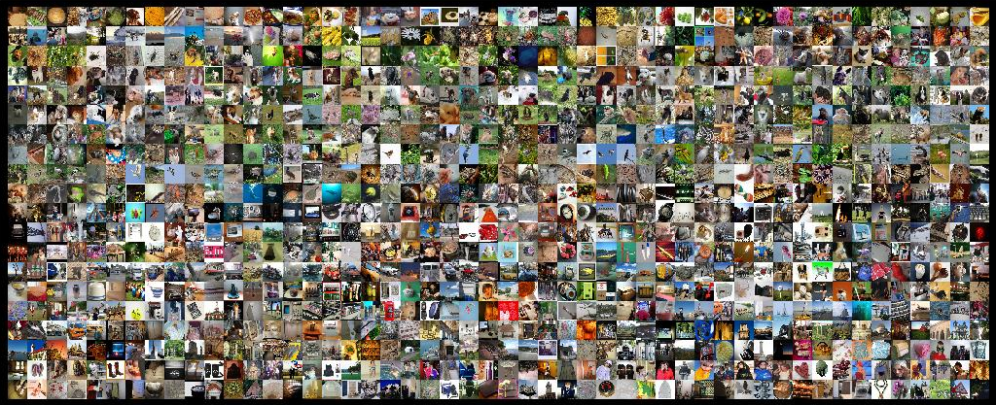

Slide 5
Finally in 2009 ImageNet was delivered.
Database of 15,000,000 images in 22,000 categories.
Organized by everyday English words.
High resolution images.

Slide 6
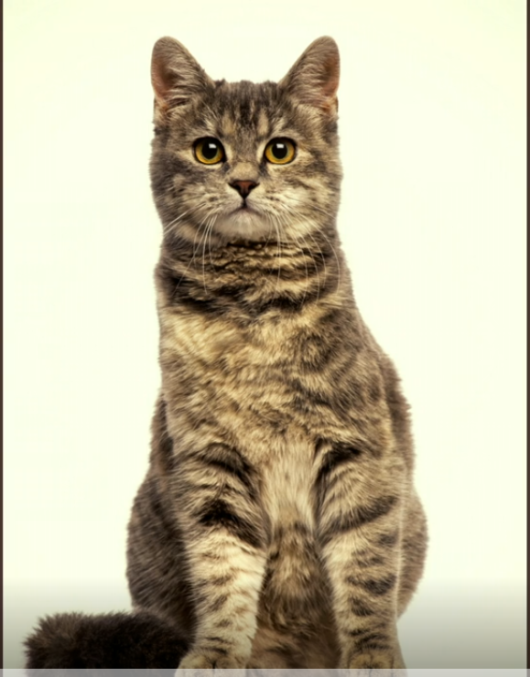
WHY
How do computer recognize this object?

Slide 7
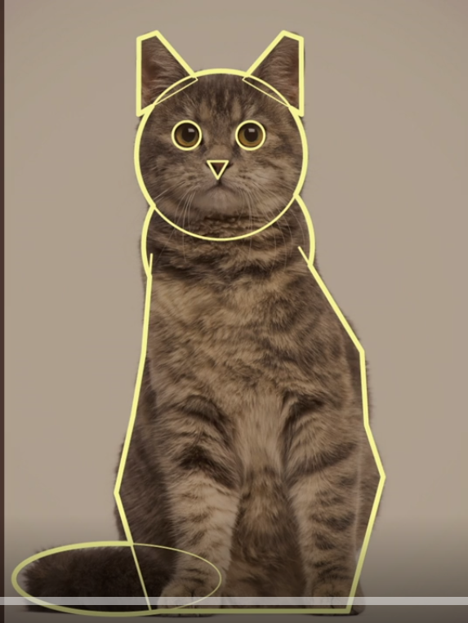
Train the computer by giving its shape and colors. Computer algorithm in mathematical language.

Slide 8
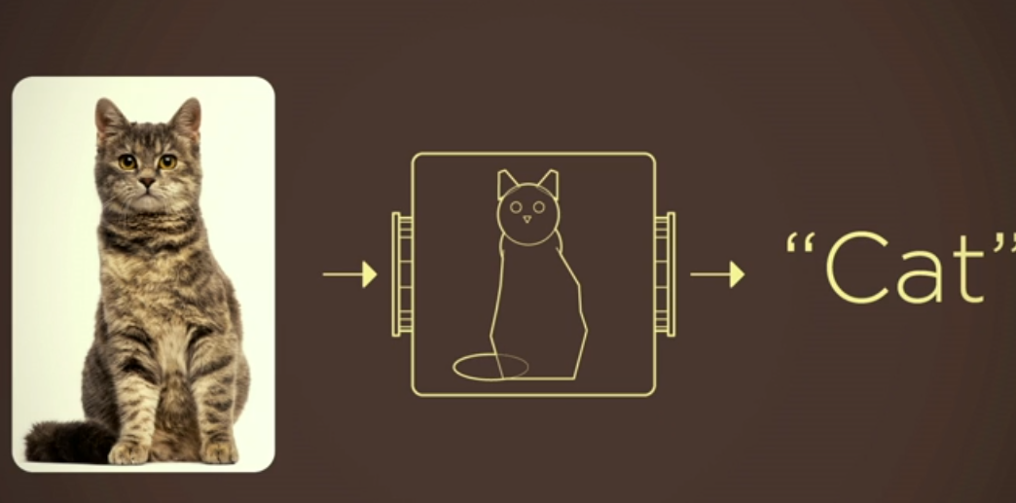

Slide 9


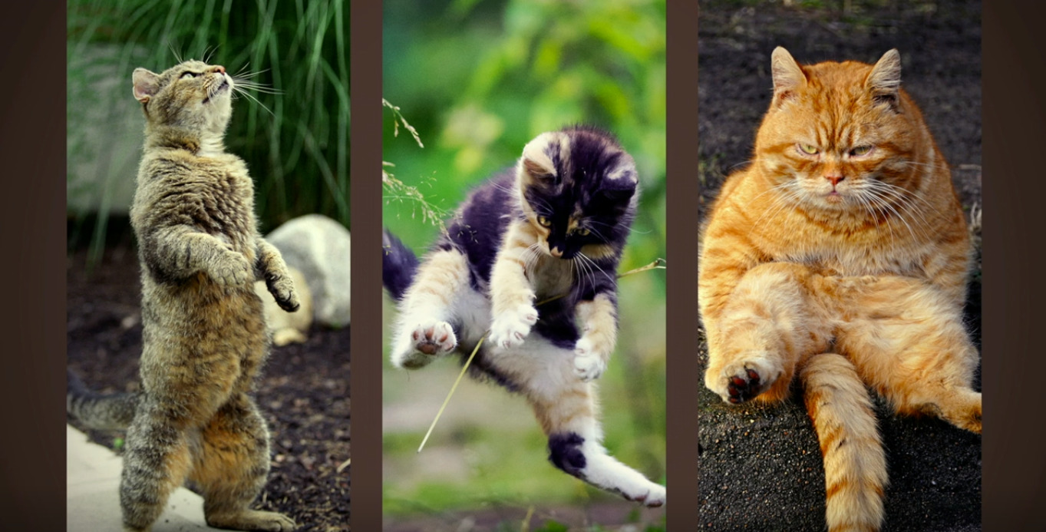

Slide 10
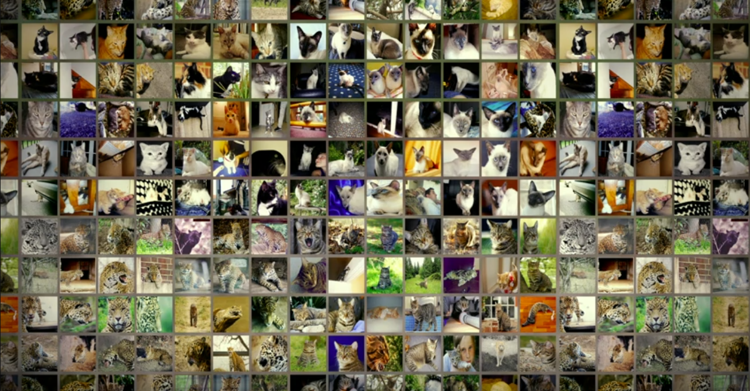
EXAMPLE
62,000 cats of all types of looks and poses of all domestic and wild cats species.

Slide 11
ILSVRC
Annual competition called the ImageNet Large-Scale Visual Recognition Challenge (ILSVRC) has been held in 2012.
Uses a subset of ImageNet with roughly 1000 images in each of 1000 categories.
1.2 million training images, 50,000 validation images, and 150,000 testing images.

Slide 12
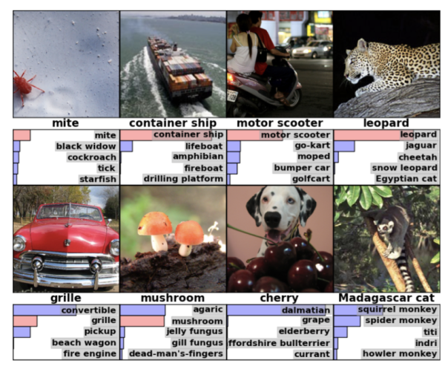
Classification goals:
Make 1 guess about the label - Top-1 error
Make 5 guesses about the label - Top-5 error

Slide 13
Normalization
Variable-resolution images.
System requires a constant input dimensionality.
Down-sampled the images to a fixed resolution of 256 × 256
Subtracting the mean activity over the training set from each pixel.
So, trained network on the (centered) raw RGB values of the pixels.

Slide 14
ALEXNET
AlexNet is the first deep architecture which was introduced by one of the pioneers in deep learning – Geoffrey Hinton and his colleagues.
AlexNet is the name of a convolutional neural network, originally written with CUDA to run with GPU support.
A convolutional neural network (CNN, or ConvNet) is a class of deep, feed-forward artificial neural networks that has successfully been applied to analyzing visual imagery.

Slide 15
Architecture:
It is a simple yet powerful network architecture, which helped pave the way for groundbreaking research in Deep Learning as it is now.
Here is a representation of the architecture.

Slide 16
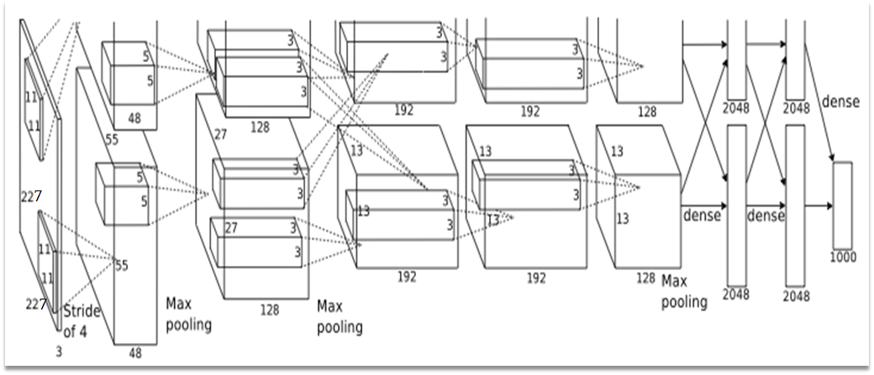

Slide 17
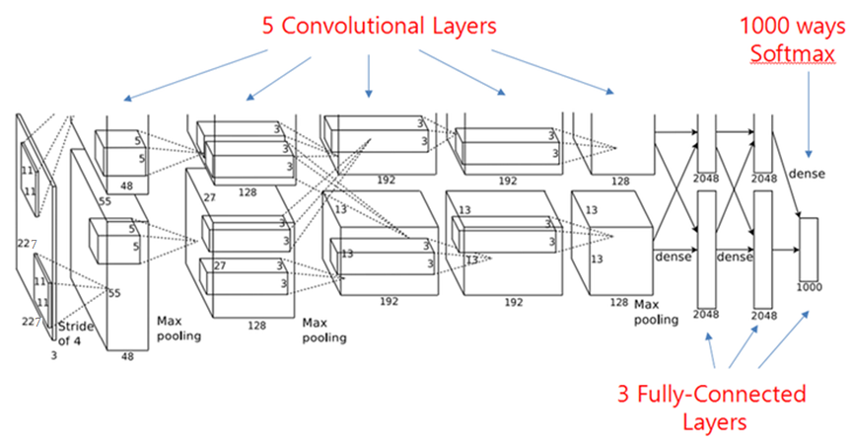

Slide 18
It contains eight learned layers.
five convolutional and pooling layers.
followed by three fully connected layers.
This is a very simple architecture, which was conceptualized way back in 1980s.

Slide 19
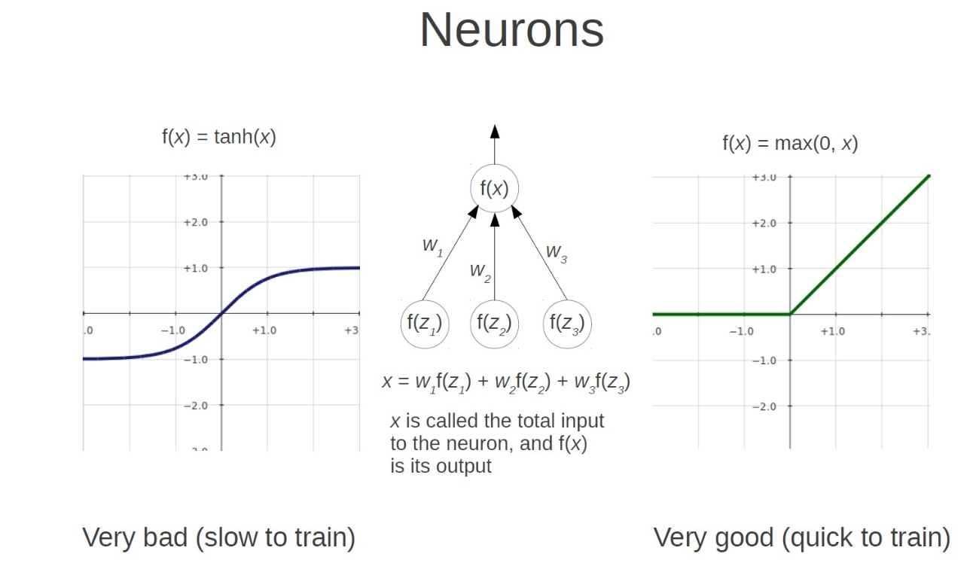
ReLU Nonlinearity
Nonlinearity as Rectified Linear Units.

Slide 20
Training on multiple GPU’s.
In 1980s, CPU was used for training a neural network.
Whereas AlexNet speeds up the training by 10 times just by the use of GPU.
A single GTX 580 GPU has only 3GB of memory, which limits the maximum size of the networks

Slide 21
Training on multiple GPU’s.
1.2 million training examples are too big to fit on one GPU.
We spread the net across two GPUs.
Current GPUs are particularly well-suited to cross-GPU parallelization.
This scheme reduces our top-1 and top-5 error rates by 1.7% and 1.2%, respectively.

Slide 22
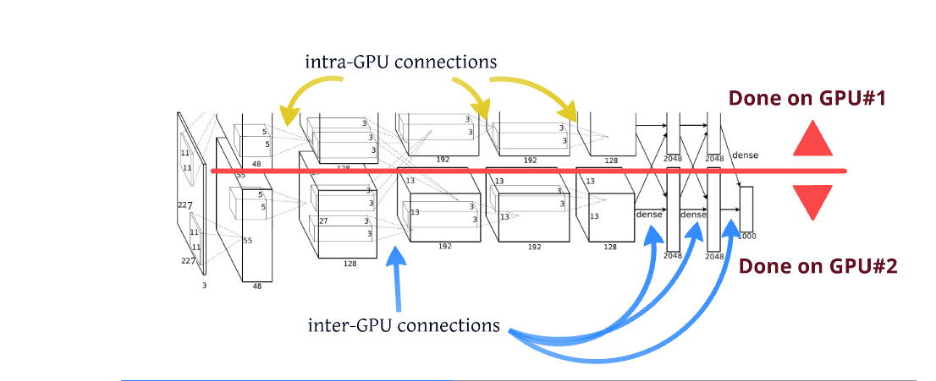

Slide 23
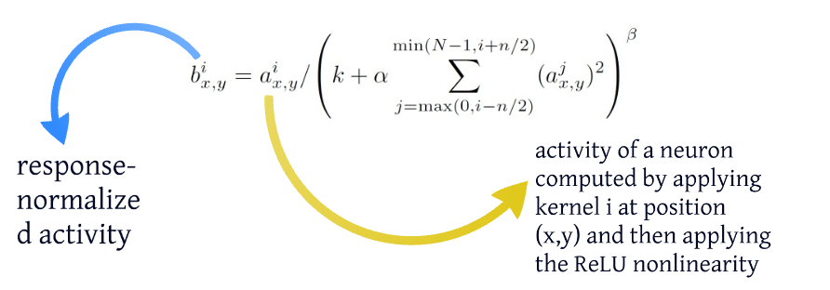
Local Response Normalization
Local Normalization Scheme aids Generalization.
They used k = 2, n = 5, α = 10^-4 , and β = 0.75, which are determined using validation sets.
Response normalization reduces our top-1 and top-5 error rates by 1.4% and 1.2%, respectively.

Slide 24
Overlapping Pooling
Pooling layers in CNNs summarize the outputs of neighboring groups of neurons in the same kernel.
Traditionally, a given pixel is used only in one of the pooling neuron.
They propose to overlap the pooling windows so that the same pixel can be used by two different pooling neurons.

Slide 25
Pooling layer can be thought of as consisting of a grid of pooling units with s pixels of size z × z.
If we set s = z - local pooling.
If we set s < z - overlapping pooling.
We use throughout network, with s = 2 and z = 3.
This scheme reduces the top-1 and top-5 error rates by 0.4% and 0.3%, respectively.

Slide 26
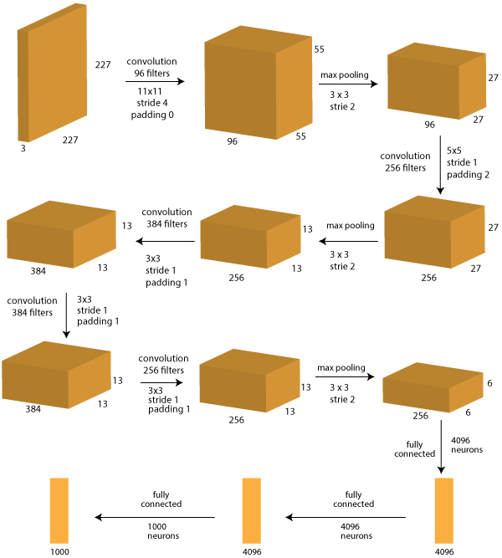

Slide 27
Layer 0: Input image
Size: 227 x 227 x 3
Note that in the paper referenced above, the network diagram has 224x224x3 printed which appears to be a typo.
Layer 1: Convolution with 96 filters, size 11×11, stride 4, padding 0
Size: 55 x 55 x 96
(227-11)/4 + 1 = 55 is the size of the outcome
96 depth because 1 set denotes 1 filter and there are 96 filters
Layer 2: Max-Pooling with 3×3 filter, stride 2
Size: 27 x 27 x 96
(55 – 3)/2 + 1 = 27 is size of outcome
depth is same as before, i.e. 96 because pooling is done independently on each layer
Layer 3: Convolution with 256 filters, size 5×5, stride 1, padding 2
Size: 27 x 27 x 256
Because of padding of (5-1)/2=2, the original size is restored
256 depth because of 256 filters
Layer 4: Max-Pooling with 3×3 filter, stride 2
Size: 13 x 13 x 256
(27 – 3)/2 + 1 = 13 is size of outcome
Depth is same as before, i.e. 256 because pooling is done independently on each layer
Layer 5: Convolution with 384 filters, size 3×3, stride 1, padding 1
Size: 13 x 13 x 384
Because of padding of (3-1)/2=1, the original size is restored
384 depth because of 384 filters

Slide 28
Layer 6: Convolution with 384 filters, size 3×3, stride 1, padding 1
Size: 13 x 13 x 384
Because of padding of (3-1)/2=1, the original size is restored
384 depth because of 384 filters
Layer 7: Convolution with 256 filters, size 3×3, stride 1, padding 1
Size: 13 x 13 x 256
Because of padding of (3-1)/2=1, the original size is restored
256 depth because of 256 filters
Layer 8: Max-Pooling with 3×3 filter, stride 2
Size: 6 x 6 x 256
(13 – 3)/2 + 1 = 6 is size of outcome
Depth is same as before, i.e. 256 because pooling is done independently on each layer
Layer 9: Fully Connected with 4096 neuron
In this later, each of the 6x6x256=9216 pixels are fed into each of the 4096 neurons and weights determined by back-propagation.
Layer 10: Fully Connected with 4096 neuron
Similar to layer #9
Layer 11: Fully Connected with 1000 neurons
This is the last layer and has 1000 neurons because IMAGENET data has 1000 classes to be predicted.

Slide 29
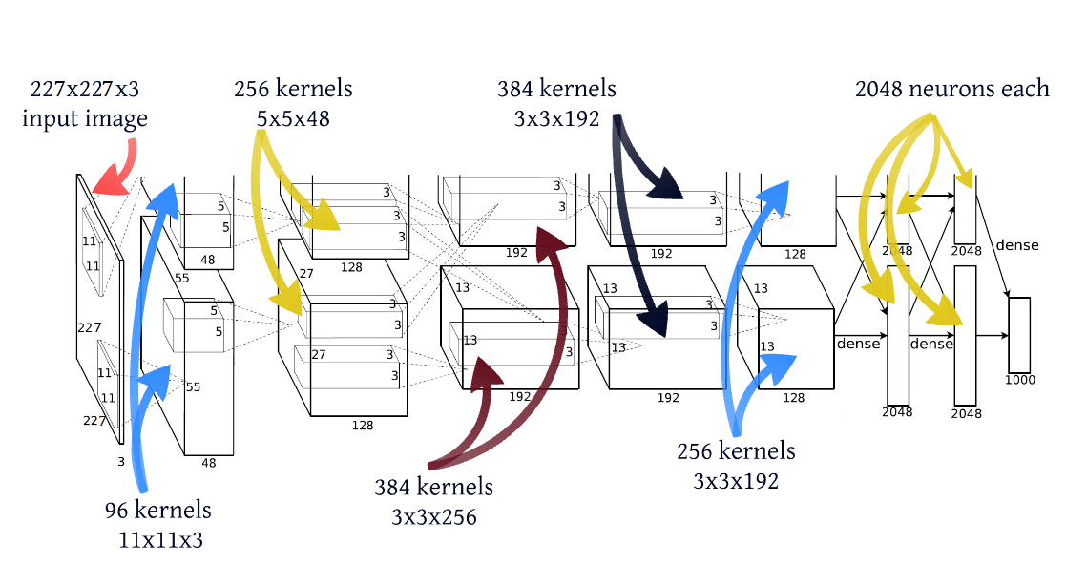

Slide 30
Reducing Overfitting
The architecture has 60 million parameters.
This turns out to be insufficient to learn so many parameters which causes danger of overfitting.
The two primary ways in which we combat overfitting.
Data Augmentation
Dropout

Slide 31
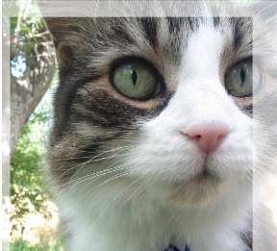
Data Augmentation
Label-preserving transformations
Artificially enlarge the dataset using label-preserving transformations.
Extracting random 224 × 224 patches (and their horizontal reflections) from the 256×256 images and training our network on these extracted patches

Slide 32
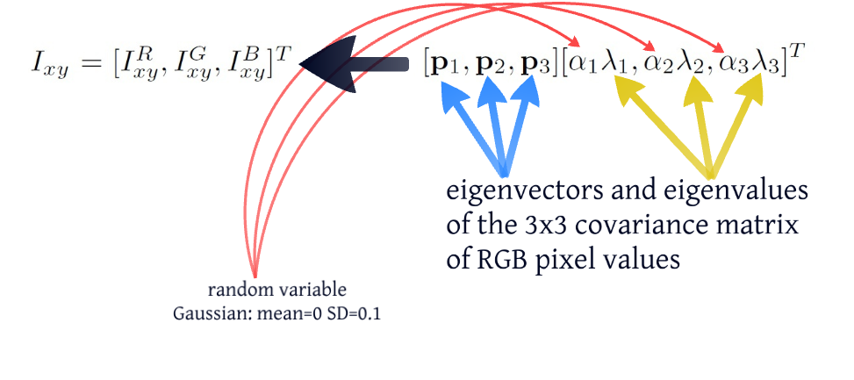
Altering the intensities of the RGB channels in training images.
Perform PCA on the set of RGB pixel values throughout the ImageNet training set. RGB image pixel is given by,

Slide 33
This scheme captures an important property that natural images are invariant to changes in the intensity and color of the illumination.
This reduces the top-1 error rate by over 1%.

Slide 34
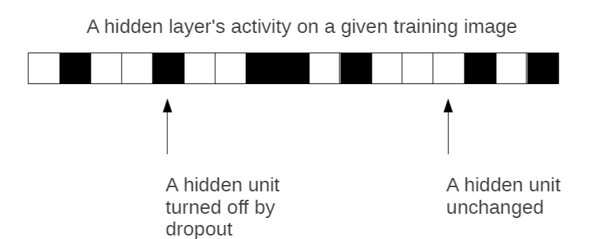
DROPOUT
Setting to zero the output of each hidden neuron with probability 0.5.

Slide 35
The neurons which are “dropped out” in this way do not contribute to the forward pass and do not participate in backpropagation
We use dropout in the first two fully-connected layers
Without dropout, our network exhibits substantial overfitting.
This doubles the number of iterations required.

Slide 36
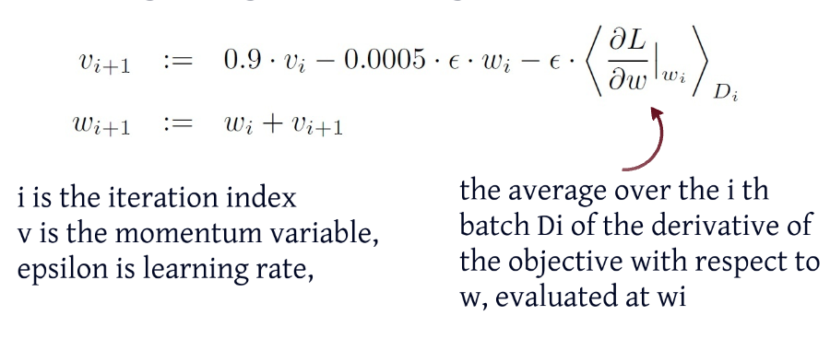
Details of learning
Trained our models using stochastic gradient descent.
Batch size - 128 examples, momentum - 0.9, and weight decay of 0.0005
Weight decay reduces the model’s training error

Slide 37

Initialized the weights in each layer from a zero-mean Gaussian distribution with standard deviation 0.01
Initialized the neuron biases in the second, fourth, and fifth convolutional layers, as well as in the fully-connected hidden layers, with the constant 1

Slide 38
The heuristic which we followed was to divide the learning rate by 10.
The learning rate was initialized at 0.01 and reduced three times prior to termination.
Trained the network for roughly 90 cycles through the training set of 1.2 million images, which took five to six days on two NVIDIA GTX 580 3GB GPU’s.

Slide 39
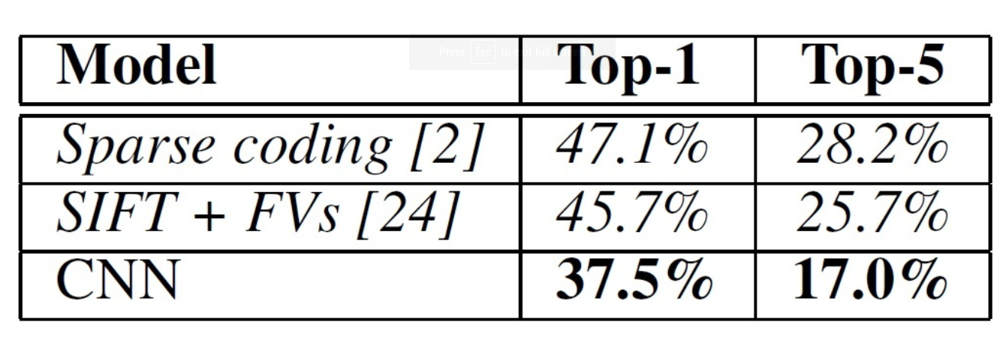
Results

Slide 40
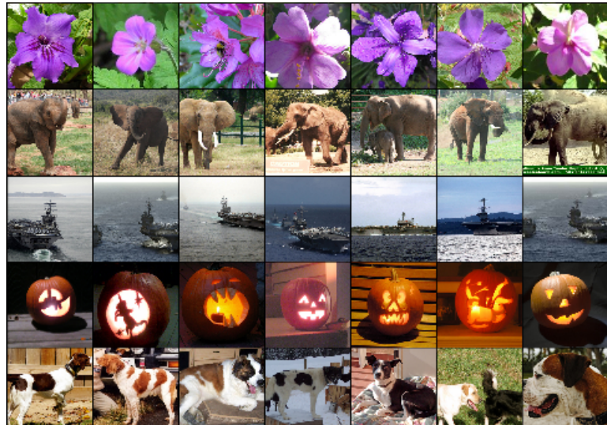
Result Classification

Slide 41
Why its important?
This was the first time a model performed so well on a historically difficult ImageNet dataset.
AlexNet is still used as a starting point for applying deep neural networks for all the tasks, whether it be computer vision.
Utilizing techniques that are still used today, such as data augmentation and dropout.
The things which set apart this model is the scale at which it performs the task and the use of GPU for training.

Slide 42


